Slide 1

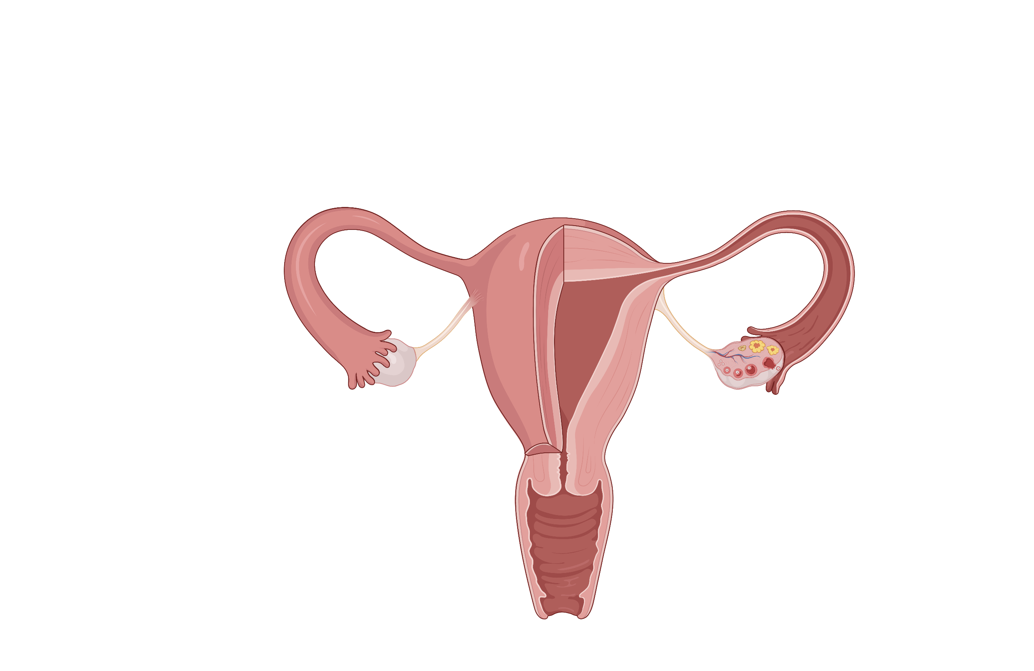

Abnormal Uterine Bleeding
What is AUB?
Causes
Work-up
Cases
BONUS: HPO axis

Slide 2




What is AUB?
What is abnormal uterine bleeding (AUB)?
Causes
Duration
Regularity
Duration
Regularity
Work-up
High variation in cycle length.
Generally, cycle length should vary by:
≤9 d if age <25 or > 45
≤7 d if age 26 - 41
Cases
Menses lasting >8 days
Frequency
Frequency
Volume
Volume
Subjective: Interferes with patient’s life, job, well-being, etc.
Objective:
Changing pad/tampon q2h
Changing pad/tampon overnight
Symptomatic
Absent
(amenorrhea)
No menses x 3 mos
Infrequent
(oligo-)
Cycle >q 35 days
Frequent
(poly-)
Cycle <q 21 days

Slide 3
What is AUB?
What causes AUB?
Causes
The first step is to rule out pregnancy.
Use the PALM-COEIN mnemonic to develop a differential
Work-up
AUB
Cases
Not pregnant
Pregnant?
Click until mouse cursor disappears
PALM (structural)
COEIN (nonstructural)
PALM (structural)
COEIN (nonstructural)
P: Polyp
C: Coagulopathy
A: Adenomyosis
O: Ovulatory Dysfunction
L: Leiomyoma (Fibroid)
E: Endometrial
M: Malignancy/Hyperplasia
I: Iatrogenic
N: Not yet classified
BONUS: HPO axis

Slide 4


What is AUB?
How do you work-up AUB?
Causes
Exam
All patients with AUB require the following basic tests:
Exam
Labs
Labs
Pregnancy Test
CBC
Iron studies
Work-up
Pelvic Exam
Basic Workup
Structural
Functional
Cases
BONUS: HPO axis

Slide 5



What is AUB?
How do you work-up AUB?
Causes
All patients with AUB require the following basic tests:
Exam
Labs
Pregnancy Test
CBC
Iron studies
Work-up
Pelvic Exam
Basic Workup
Structural
Further work-up of structural causes?
Further work-up of nonstructural causes?
Further work-up of structural causes?
Further work-up of nonstructural causes?
Nonstructural
Transvaginal ultrasound
Cases
Additional History
± Endometrial biopsy
Risk factors for hyperplasia
peri- or post-menopause
chronic anovulation
unopposed estrogen exposure
tobacco use
How do we initiate cause-specific workups?
Who should receive an endometrial biopsy?
Who should receive an endometrial biopsy?

Slide 6

What is AUB?
How do you work-up functional causes of AUB?
Causes
Patient Presentation
Clues
Evaluation
Coagulopathy
Strong personal or family bleeding history
Heavy menses since menarche
Very heavy periods since menarche, soaking through pads. Mom has recurrent nosebleeds.
Clues to diagnosis?
Next steps in evaluation?
Work-up
Von Willebrand panel
PT/INR, PTT,
Factor activity
Basic Workup
Structural
Ovulatory dysfunction
Irregular menses since menarche with insulin resistance and facial hair.
Clues to diagnosis?
Next steps in evaluation?
Exam
Diagnosis
Evaluation
Hirsutism
PCOS
Total testosterone, 17-OH progesterone, ± DHEAS
Nonstructural
Breast discharge
Prolactinoma
Prolactin, TSH
Cases
Hot flashes
Perimenopause
FSH
Weight ↑
Cushing’s, ↓thyroid
TSH
Weight ↓
Stress, anorexia, ↑thyroid
TSH
Pain with intercourse + irregular, light bleeding and vaginal discharge
Next steps in evaluation?
Endometrial
Clues to diagnosis?
Sexual history, inflammatory conditions
STI testing
Recently placed Nexplanon with irregular spotting.
Medical history
Medication
Recent surgeries/procedures
Iatrogenic
Clues to diagnosis?
Next steps in evaluation?
Address underlying cause
BONUS: HPO axis
Notes:
Vignette as top row? -> rapid fire vignettes to help with quick recognition/illness scripts
If patient presents with these clinical features, what are you worried about?
What are your next steps in evaluation and management?
Replace vignette with “C: Coagulopathy” once you click the button, then workup, then management
Yilin.zhang37@gmail.com 904-891-8838

Slide 7
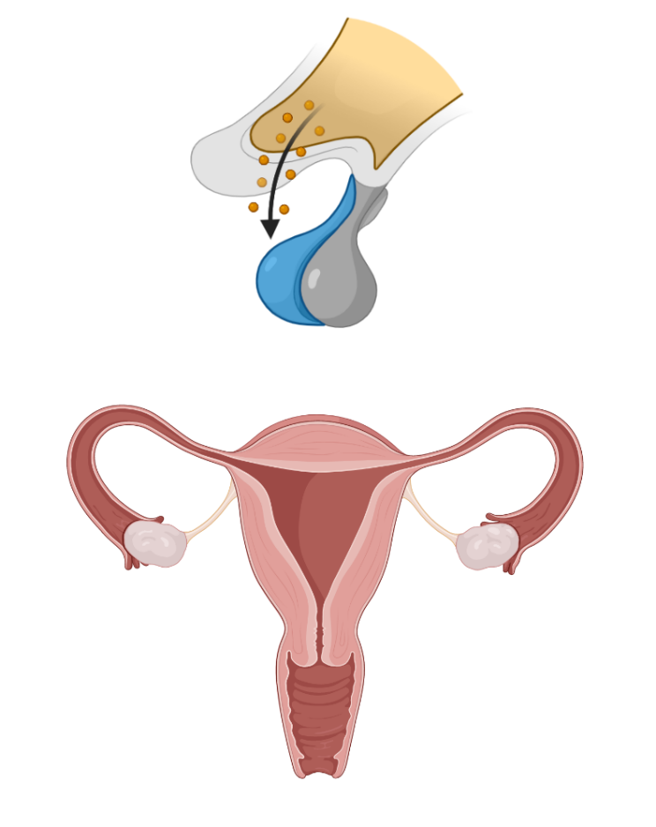

What is AUB?
Hypothalamic-Pituitary-Ovarian Axis
Causes
Hypothalamus secretes GnRH which acts on the anterior pituitary (AP)
Hypothalamus?
How does hypothyroidism cause menstrual irregularities?
Hypothalamus
Work-up
GnRH
Basic Workup
Anterior Pituitary?
Anterior Pituitary
Structural
(AP) secretes TSH, FSH/LH, and prolactin.
FSH/LH
Nonstructural
TSH
Prolactin
How does the physiology of menopause explain the elevated FSH we see in perimenopausal patients?
Ovaries
Ovaries?
Cases
Estradiol
Progesterone
FSH/LH acts on the ovaries to secrete estradiol/ progesterone.
Uterus
Vagina
BONUS: HPO axis

Slide 8
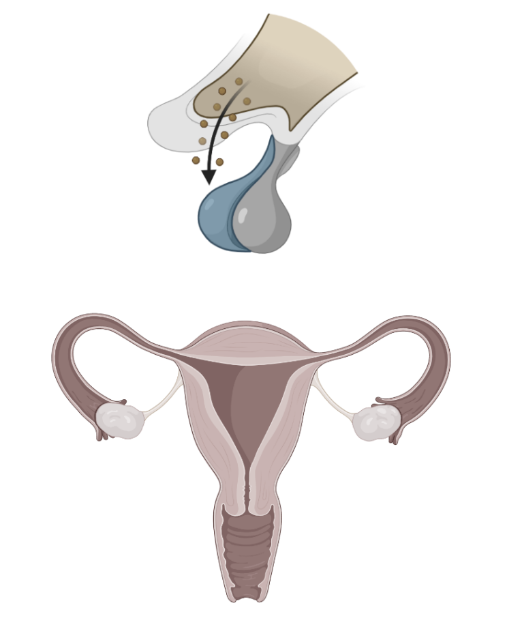
What is AUB?
Hypothalamic-Pituitary-Ovarian Axis
Causes
Hypothalamus
How does hypothyroidism cause menstrual irregularities?
Work-up
2
2
GnRH
Hypothyroidism → ↑ TSH levels
Basic Workup
TSH provides negative feedback to hypothalamus → ↓ GnRH
Anterior Pituitary
Structural
↓ GnRH → ↓ FSH/LH ovarian → ↓ stimulation to ovulate
FSH/LH
3
1
3
1
Functional
TSH
How does the physiology of menopause explain the elevated FSH we see in perimenopausal patients?
Ovaries
Cases
Estradiol
Progesterone
Uterus
Vagina
BONUS: HPO axis

Slide 9
What is AUB?
Hypothalamic-Pituitary-Ovarian Axis
Causes
Hypothalamus
How does hypothyroidism cause menstrual irregularities?
Work-up
GnRH
Basic Workup
Anterior Pituitary
2
2
3
Structural
3
FSH/LH
Functional
How does the physiology of menopause explain the elevated FSH we see in perimenopausal patients?
Ovaries
Cases
1
1
Estradiol
Progesterone
Peri-menopause is due to ↓ estrogen production at the ovary
Uterus
↓ estrogen → ↑ GnRH production at the hypothalamus
↑ GnRH → ↑ FSH/LH
Vagina
BONUS: HPO axis

Slide 10
What is AUB?
Case 1
Case 2
Causes
32 yo F presenting with self-reported “heavy periods” for the past 12 mos. She has a period every 26-28 days that lasts 8 -9 days. She soaks through a pad every 2 hours on heavy days and has had blood soak through her pants. Her periods previously lasted 4-5 days and were not as heavy. No other major changes in the last year.
Pelvic exam: mildly enlarged uterus and no other major abnormalities.
Labs: iron deficiency without anemia, negative pregnancy test.
39 yo F presents for ”irregular periods”. She reports that for the last 2 years, she has been having increasingly infrequent periods occurring every 40-60 days. Her menstrual bleeding is variable in volume. She has a family history of celiac disease and lupus.
ROS: fatigue, hair loss, and an unintentional 15-pound weight gain over the last 2 years.
Pelvic exam is unremarkable.
Labs: negative pregnancy test, normal blood counts, coagulation markers, no iron deficiency.
Work-up
Cases
Is this abnormal uterine bleeding (AUB)?
What is her bleeding pattern?
Yes. It is heavy (high volume) and prolonged (long duration).
Infrequent (oligomenorrhea, cycles > 35d) and irregular (variable cycle length)
What is the most likely cause of AUB?
What is the most likely cause of AUB?
Structural cause, most likely fibroids or adenomyosis considering physical exam findings.
Ovulatory dysfunction, most likely from endocrine causes (e.g., hypothyroidism - fatigue, hair loss, weight gain). Given age, premature ovarian failure can be considered.
What additional evaluation should be considered?
What is your next step in evaluation?
Transvaginal ultrasound
Pregnancy test, TSH, prolactin, ± FSH. Consider total testosterone if risk factors for PCOS.
Notes:
Make case 1 perimenopausal – talk about endometrial biopsy as next step

Slide 11

Defining AUB:
1.
2.
3.
4.
Abnormal Uterine Bleeding
Clues on history/ exam
Initial Workup
PALM (structural)
COEIN (non-structural)
P:
A:
L:
M:
C:
O:
E:
I:
N:
Workup for all-comers:
Physical exam (1):
Labs (3):
Additional starting workup:
Structural cause?
Non-structural cause?

Slide 12
2018 FIGO Update & Currency Note (verified June 2026)
Standing framework is current: the FIGO PALM-COEIN system (Munro, Int J Gynecol Obstet 2018 revision) and the AUB definitions taught here remain the accepted standard. No change to the teaching.
Correction made to this deck: the "I" in PALM-COEIN is IATROGENIC, not "Idiopathic" — i.e., hormonal contraception (IUDs, implants such as Nexplanon), anticoagulants, SERMs (tamoxifen/raloxifene), and dopamine antagonists. ("Idiopathic" was a transcription slip; FIGO and the lesson script both say Iatrogenic.)
Framing reminders worth adding at the board:
FIGO normal-cycle limits: frequency 24–38 d, duration ≤8 d, cycle-to-cycle variation ≤7–9 d (age-dependent).
Any post-menopausal bleeding is abnormal until proven otherwise → transvaginal US ± endometrial biopsy to exclude endometrial cancer.
Levonorgestrel IUD and tranexamic acid are first-line medical options for heavy menstrual bleeding from non-structural / fibroid causes (ACOG).

Slide 13
Take-Home Points
1. AUB is defined by abnormality in any of four parameters: duration (>8 d), frequency (<24 or >38 d), regularity (variation >7–9 d by age), or volume (interferes with life / objective soaking).
2. After ruling out pregnancy, use PALM-COEIN — PALM = structural (Polyp, Adenomyosis, Leiomyoma, Malignancy/hyperplasia), COEIN = non-structural (Coagulopathy, Ovulatory dysfunction, Endometrial, Iatrogenic, Not yet classified).
3. Every patient with AUB gets a pelvic exam plus three labs: pregnancy test, CBC, and iron studies (ferritin <50 ng/mL is low in pre-menopausal patients).
4. Add transvaginal ultrasound for structural work-up; endometrial biopsy for hyperplasia/cancer risk (age >45, post-menopausal bleeding, chronic anovulation/obesity, unopposed estrogen, tamoxifen).
5. ~20% of heavy menstrual bleeding (higher in adolescents) reflects a bleeding disorder — screen with vWF panel/PT/PTT when bleeding dates to menarche or there is a personal/family bleeding history.

Slide 14
Attribution, License & Optimization Notes
Original: "Abnormal Uterine Bleeding," TeachIM.org. Authors: Nikki Zarling MD, Natalie deQuillfeldt MD, Brandon Fainstad, Molly Brett MD; sec. ed. Adelaide McClintock MD; exec. ed. Yilin Zhang MD. Published April 2022.
teachim.org/teaching_material/abnormal-uterine-bleeding/ — CC BY-NC 4.0 (attribution, non-commercial). Educational use only; clinician-reviewed before teaching.
Optimization (June 2026):
Correction (surgical, all click-to-reveal animations & graphics preserved): PALM-COEIN "I: Idiopathic" → "I: Iatrogenic" on slide 3 (mnemonic legend) and slide 6 (the Nexplanon vignette reveal label). Matches FIGO 2018 and the lesson's own teaching script.
Added: this 2018-FIGO currency slide, take-home slide; HTML package (pre-work, ASK points, click-to-reveal cases), 5 MCQs, 17 Anki cards, EMR dotphrase, one-pager PDF.
Companions copied & linked (reviewed, unchanged): Teaching Guide (AUB-Teach-IM-Guide-final.docx) + Learner Worksheet (Learner-Worksheet-1.pdf).
All 11 original slides (1 hidden worksheet) preserved → 14 total.

